Slide 1
MOD006671 Quantitative Methods for Banking and Finance
Week 4
Sampling & Hypothesis Testing

Slide 2

Learning outcomes
Identify the six steps of hypothesis testing.
Define null hypothesis, alternative hypothesis, level of significance, test statistic, $p$ value, and statistical significance.
Define Type I error and Type II error, and identify the type of error that researchers control.
Calculate the one-independent sample z test and interpret the results.
Distinguish between a one-tailed and two-tailed test

Slide 3
Population and sample
Population: All items under investigation. The group of items or people about which information is required.
Sample: A group of items taken from the population for examination.
Sampling frame: A list of all members of a population from which items are to be selected.
Random sample: A sample in which all items in a population have an equal chance of being selected.

Slide 4
Population
CONCLUSIONS?
GETTING DATA?
Not 100% certain
Use probabilities
Inference
Confidence intervals
Trials
Studies
Experiments
SUMMARISING DATA?
Sample
Relationships
Percentages/Averages/Variation
Tables and Graphs
Averages
A sample which contains more than 30 items is counted as large

Slide 5
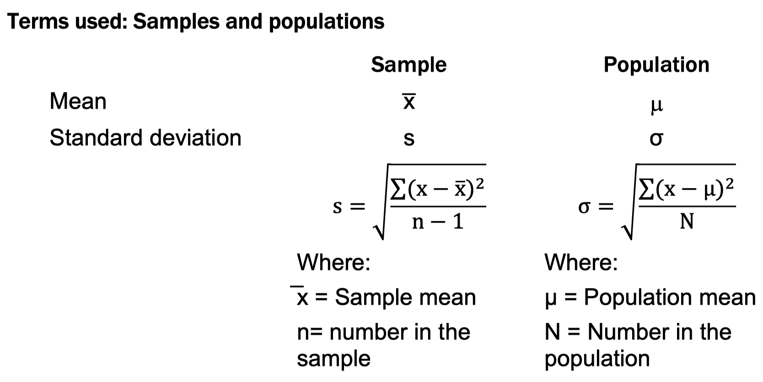
Statistical inference

Slide 6

The Sampling Distribution
Suppose you own a factory producing fluorescent light tubes. It would be very useful, both for advertising and for monitoring the efficiency of your plant, to know the average length of life of these tubes. Clearly it is not possible to test every tube, so you take a random sample of size $n$, measure $x$ hours, the life of each tube, and then calculate $\overline{x}$ and $s$. These values will be estimates of the population parameters $µ$ and $σ$.
The distribution of $\overline{x}$ is called the sampling distribution of the mean

Slide 7
Standard Error of the Mean
Different samples of the same size from the same population will yield different sample means
A measure of the variability in the mean from sample to sample is given by the Standard Error of the Mean:
(This assumes that sampling is with replacement or
sampling is without replacement from an infinite population)
Note that the standard error of the mean decreases as the sample size increases

Slide 8

Sample Mean Sampling Distribution: If the Population is Normal
If a population is normal with mean $μ$ and standard deviation $σ$,
Then, the sampling distribution of $\overline{X}$ is also normally distributed with:
and

Slide 9
Explained by: Central Limit Theorem
the sampling distribution of the sample mean becomes almost normal regardless of shape of population
As the sample size gets large enough…
n↑

Slide 10
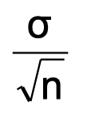

Central Limit Theorem
If the distribution of $x$ is normal with mean $μ$ and standard deviation $σ$and samples of size $n$ are taken from this distribution,
then the distribution of $x$ is also normal with:
mean $μ$ and standard deviation (SE) $σ$
whatever the size of $n$.

Slide 11
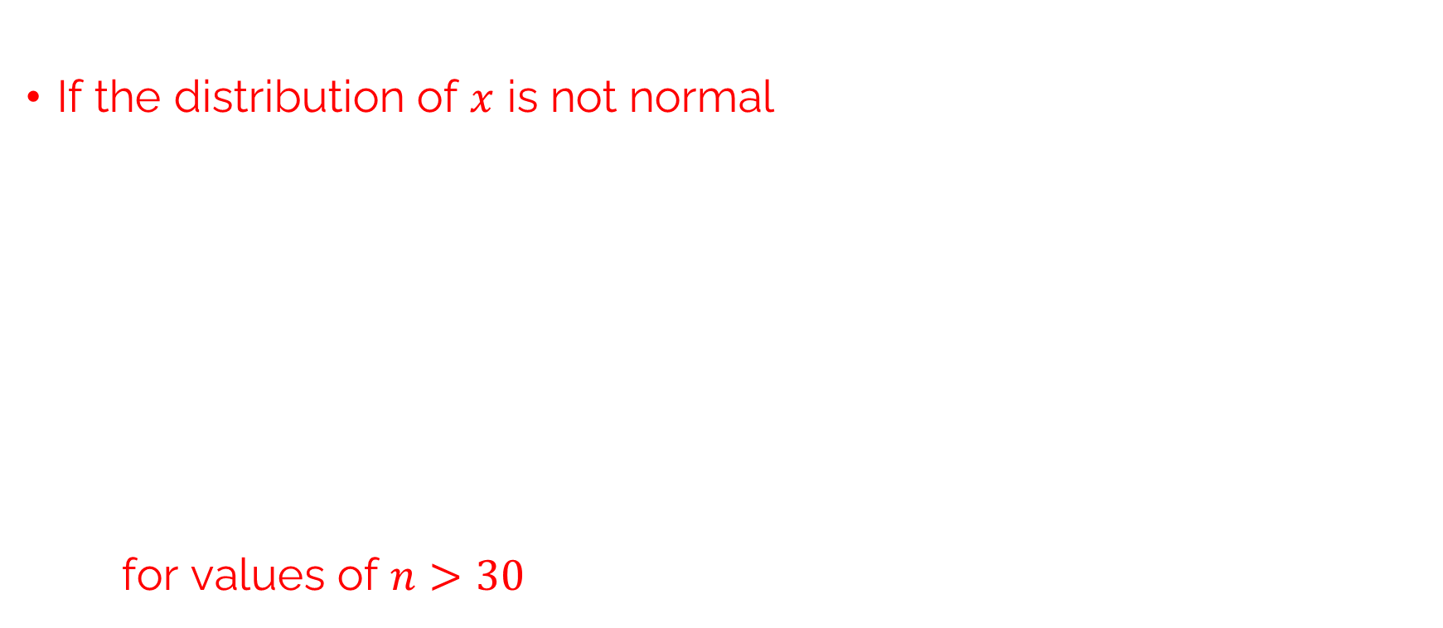
b)
If the distribution of $x$ is not normal, as the size of the sample increases,
the distribution of $x$ approaches the normal distribution with:
mean $μ$ and standard deviation
i.e. for values of $n>30$ we can assume that $x$ is normal.

Slide 12
Hypothesis Testing

Slide 13
Hypothesis Testing
A hypothesis about the value of a population parameter is an assertion about its value.
So Hypothesis testing is really a systematic way to test claims or ideas about a group or population
Therefore, Hypothesis testing or significance testing is a method for testing a claim or hypothesis about a parameter in a population, using data measured in a sample.

Slide 14
Types of Hypotheses
We are concerned with testing the truth of two competing hypotheses, only one of which can be true
The null hypothesis, denoted H₀ , is the statement about the population parameter that is assumed to be true unless there is convincing evidence to the contrary.
The alternative hypothesis, denoted H₁ , is a statement about the population parameter that is contradictory to the null hypothesis, and is accepted as true only if there is convincing evidence in favor of it.

Slide 15
The logic of hypothesis testing
The end result of a hypotheses testing procedure is a choice of one of the following two possible conclusions:
Reject H₀ (and therefore accept H₁ ),
or
Fail to reject H₀ (and therefore fail to accept H₁ ).

Slide 16
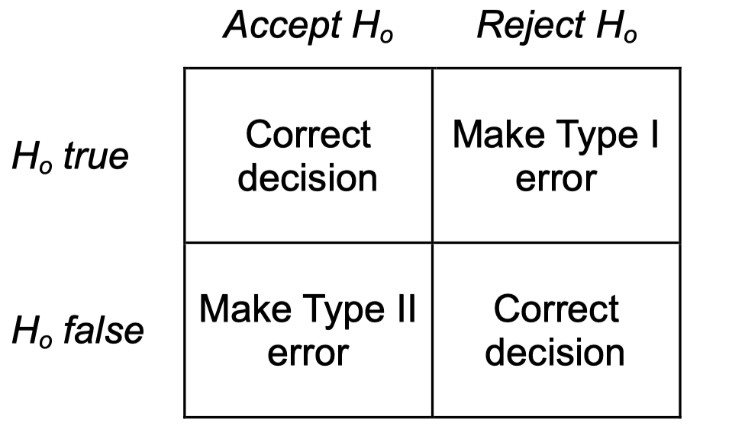
Two Types of Errors
Figure: Types of Error

Slide 17
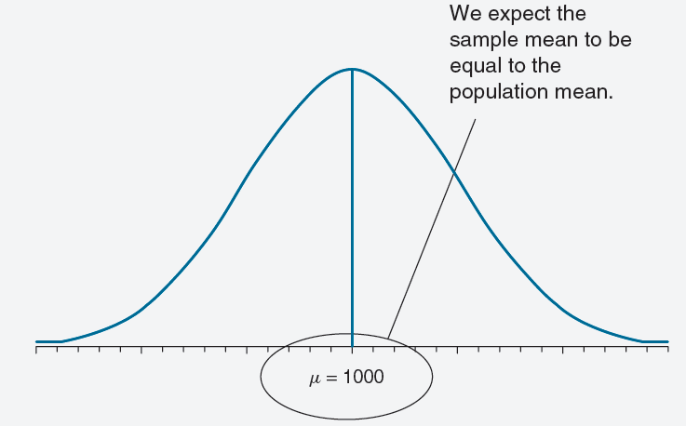
Hypothesis tests
The null hypothesis
H_{o}: the sample belongs to the population.
The alternative hypothesis
H₁: the sample does not belong to the population.

Slide 18
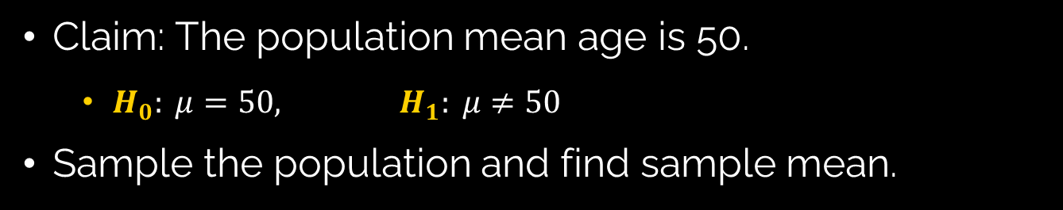
The Hypothesis Testing Concept
Claim: The population mean age is 50.
$H_{0}: μ=50, H_{1}: μ≠50$
Sample the population and find sample mean.
Population
Sample

Slide 19

The Hypothesis Testing Concept
(continued)
Suppose the sample mean age was $\overline{X}=20$.
This is significantly lower than the claimed mean population age of 50.
If the null hypothesis were true, the probability of getting such a different sample mean would be very small, so you reject the null hypothesis .
In other words, getting a sample mean of 20 is so unlikely if the population mean was 50. This indicates that such a result is unlikely to be due to random sampling variation alone. Therefore, you conclude that the population mean must not be 50.

Slide 20
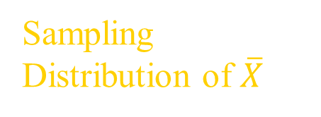
The Hypothesis Testing Concept
(continued)
Sampling Distribution of $\overline{X}$
X
20
μ = 50
If H₀ is true
... then you reject the null hypothesis that μ = 50.
If it is unlikely that you would get a sample mean of this value ...
... When in fact this were the population mean…

Slide 21

Steps for hypothesis testing
State the null hypothesis, $H_{0}$.
Decide on the alternative hypothesis, $H_{1}$ .
Choose the level of significance, thus fixing the critical region.
Calculate the mean and standard deviation of the sample, if these are not given in the problem, and the standard error of the mean.
Calculate the test. → Run test in SPSS
Interpret- Accept or reject the null hypothesis.

Slide 22
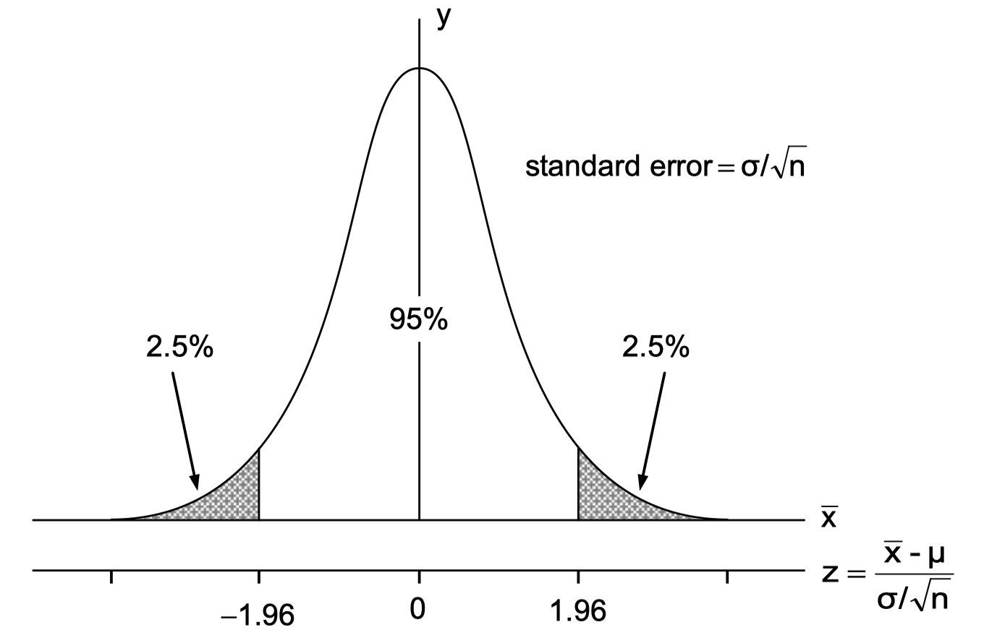

Defining Hypotheses
$H_{0}: μ=μ_{0}$ (the value of the population mean given in the problem).
$H_{1}: μ≠μ_{0}$
two-tailed test

Slide 23
Example of defining Hypotheses- two tailed
The recipe for a bakery item is designed to result in a product that contains 8 grams of fat per serving. The quality control department samples the product periodically to insure that the production process is working as designed. State the relevant null and alternative hypotheses.
Solution:
The default option is to assume that the product contains the amount of fat it was formulated to contain unless there is compelling evidence to the contrary. Thus the null hypothesis is H₀:μ=8.0 .
Since to contain either more fat than desired or to contain less fat than desired are both an indication of a faulty production process, the alternative hypothesis in this situation is that the mean is different from 8.0 , so H₁:μ≠8.0 .

Slide 24
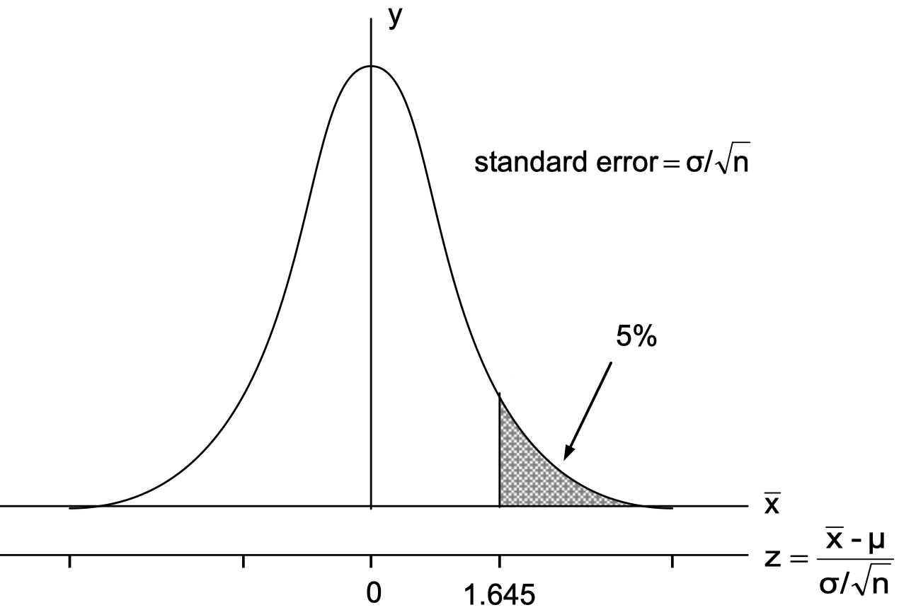

Defining Hypotheses
$H_{0}: μ=μ_{0}$(the value of the population mean given in the problem).
upper-tailed test
$H_{1}: μ>μ_{0}$
Lower-tailed test
$H_{1}: μ<μ_{0}$

Slide 25
Example of defining Hypotheses- upper tail
A publisher of college textbooks claims that the average price of all hardbound college textbooks is $127.50 . A student group believes that the actual mean is higher and wishes to test their belief. State the relevant null and alternative hypotheses.
Solution:
The default option is to accept the publisher’s claim unless there is compelling evidence to the contrary. Thus the null hypothesis is H₀:μ=127.50 .
Since the student group thinks that the average textbook price is greater than the publisher’s figure, the alternative hypothesis in this situation is H₁:μ>127.50 .

Slide 26
T Test

Slide 27

Hypothesis Tests for Small Sample ($n<30$)
When sample sizes are small, as is often the case in practice, the Central Limit Theorem does not apply.
So, If population standard deviation, σ is unknown, then we cannot assume normal distribution, then Z statistics becomes invalid
One must then impose stricter assumptions on the population to give statistical validity to the test procedure
Therefore, we use Student’s t -distribution with n−1 degrees of freedom

Slide 28
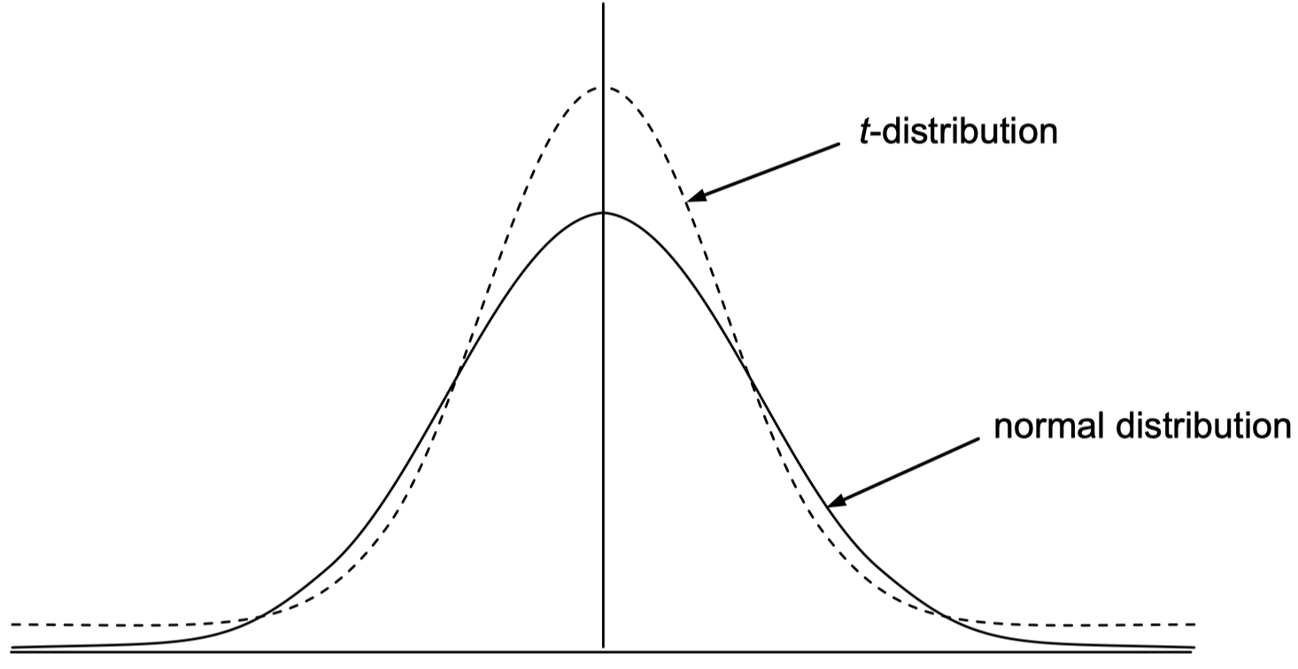

T-distribution
Note: $t→Z$ as $n$ increases

Slide 29
Critical values are from the t -distribution
First we need to calculate the degrees of freedom
degrees of freedom (df) = (n - 1)
Then look up critical values:
t values

Slide 30
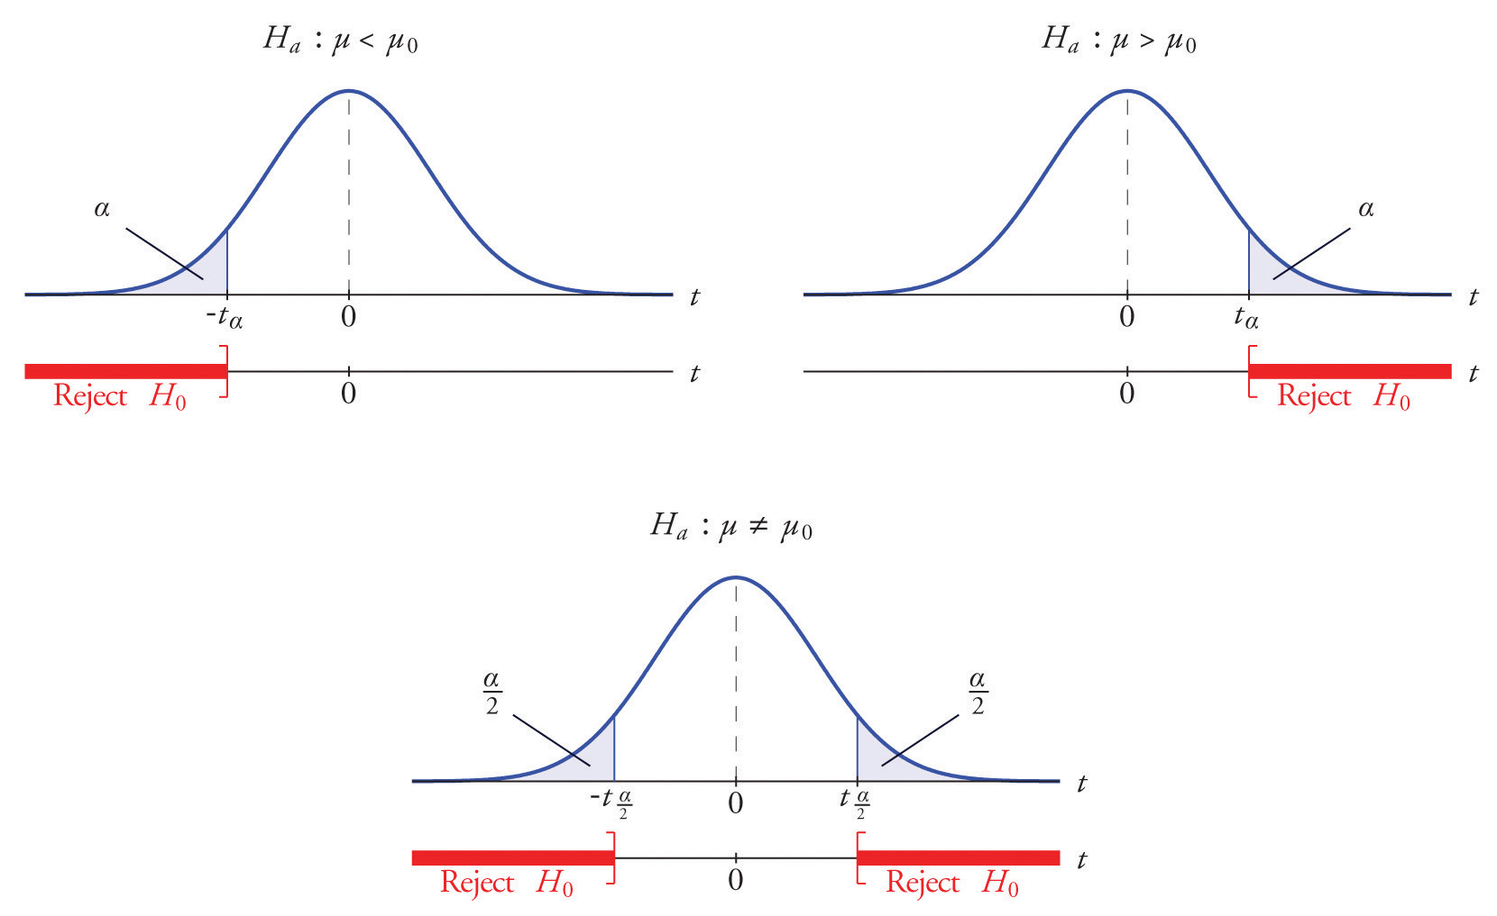
The Rejection Region

Slide 31
One Sample t Test
The One Sample t Test examines whether the mean of a population is statistically different from a known or hypothesized value.

Slide 32
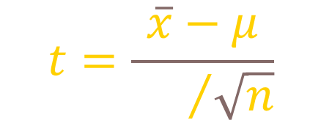
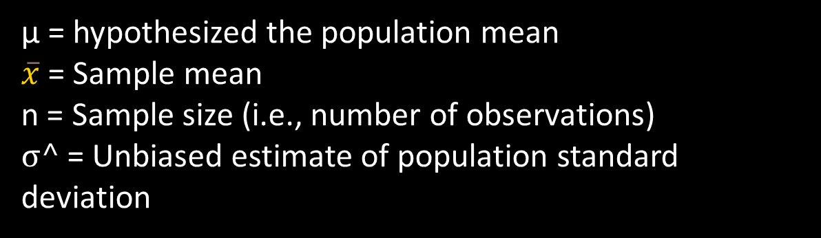
T- test statistic
$$t=\frac{\overline{x}−μ}{{\text{σ}\text{^}}/{\sqrt{n}}}$$
μ = hypothesized the population mean
$\overline{x}$ = Sample mean
n = Sample size (i.e., number of observations)
σ^ = Unbiased estimate of population standard deviation

Slide 33
Example
For example, suppose a supplier claims that his product has a content of a main ingredient of 40%. We measure the content in a sample of 5 bags of the product (chosen at random) and we obtain the following values:
38%, 32%, 44%, 37%, 34% with a mean of 37%.
Does this sample invalidate the supplier's claim?

Slide 34
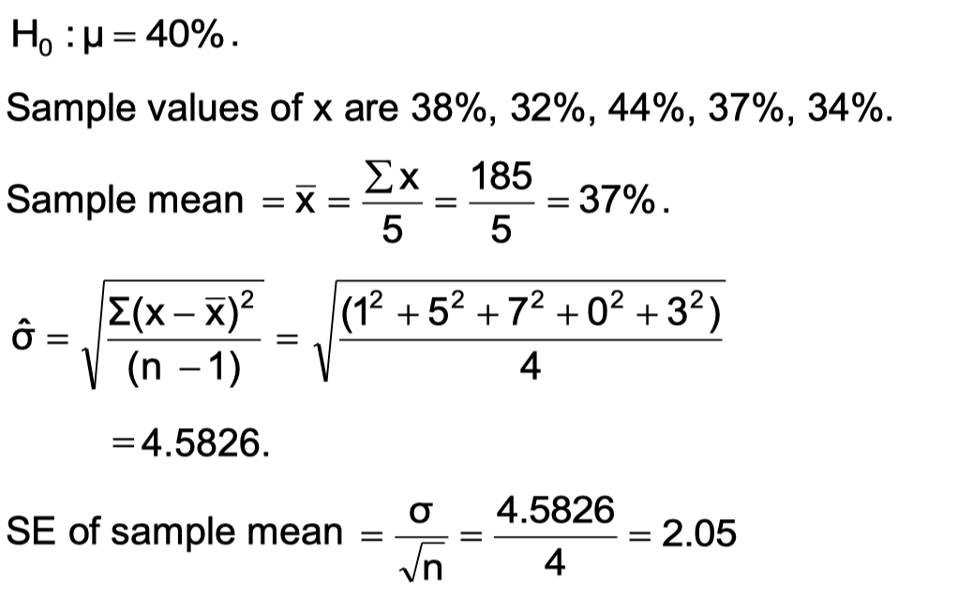
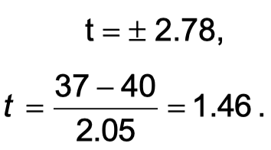
Let's do the Test
From tables, critical value of t at 5% level, two-tailed test with degrees of freedom = (n - 1) =4, is: 2.776
Notes:
The value of t lies well within the range which is consistent with the null hypothesis, so we cannot reject the null hypothesis. In terms of our original question, we do not have enough evidence to say that the average content differs from 40%.

Slide 35
Practice Question
The price of a popular tennis racket at a national chain store is $179.
Portia bought five of the same racket at an online auction site for the following prices:
$155 $179 $175 $175 $161
Determine whether there is sufficient evidence in the sample, at the 5% level of significance, to conclude that the average price of the racket is less than $179 if purchased at an online auction.

Slide 36
In SPSS
SPSS give you a ‘p value’
So, you don’t need to look up the critical values in t tables when using SPSS,
You simply interpret the p value:
If the p value is less than 0.05 (p<.05)
You Reject the Null Hypothesis.
(assuming we are using a significance level of 5%, which we commonly will be)

Slide 37
Two sample t Test aka Independent Samples t Test
The Independent Samples t Test compares the means of two independent groups in order to determine whether there is statistical evidence that the associated population means are significantly different.

Slide 38
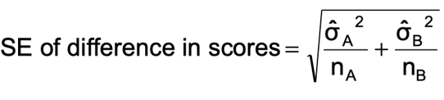
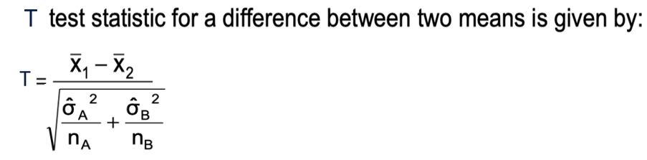

T Statistics for Difference of Two Means
Therefore:
Note:

Slide 39
The t Test- Difference of Means Test Example:
Two groups of students are asked to take a test. The results are:
Group A scores 45, 87, 64, 92, 38.
Group B scores 40, 35, 61, 50, 47, 32.
Is there a significant difference in mean score between the two groups?

Slide 40
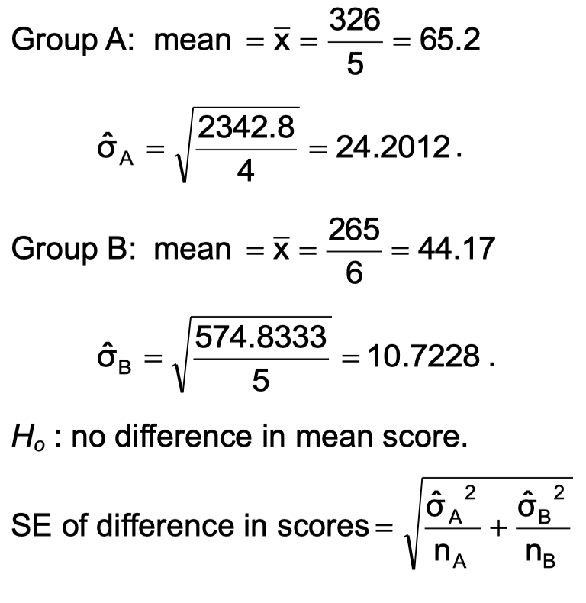
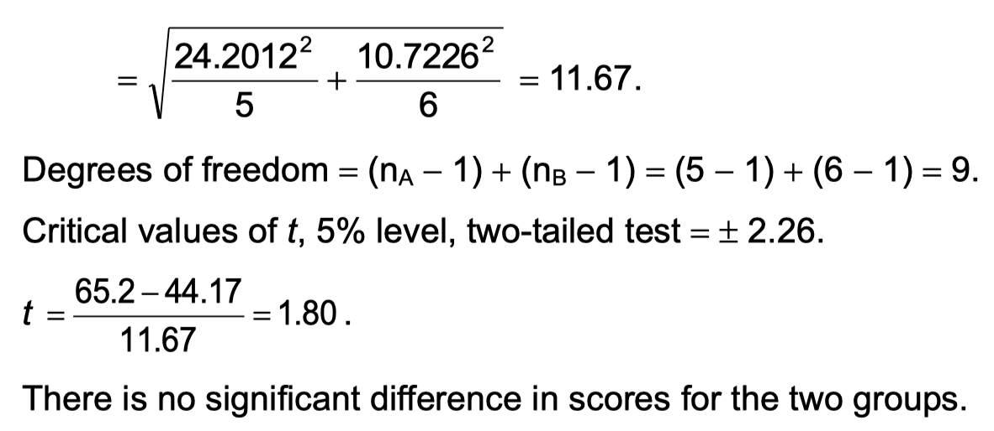

Slide 41
Practice Question
A software company markets a new computer game with two experimental packaging designs. Design 1 is sent to 11 stores; their average sales the first month is 52 units with sample standard deviation 12 units. Design 2 is sent to 6 stores; their average sales the first month is 46 units with sample standard deviation 10 units
Test at the 1% level of significance whether the data provide sufficient evidence to conclude that the mean sales per month of the two designs are different.

Slide 42
Interpreting p Value in SPSS

Slide 43
What is a p-value?
Probability of observing results as extreme as the sample
Assumes the null hypothesis is true
Small p-value = weak evidence for H₀

Slide 44
Hypothesis Testing Framework in SPSS
State H₀ and H₁
Choose significance level (α = 0.05)
Use p-value to decide

Slide 45
Decision Rule
Assuming we are using a significance level of 5%,
If p < 0.05 → Reject H₀
If p > 0.05 → Fail to reject H₀

Slide 46
Two-Tailed Test- when to use
You are testing for any difference
This tests for both higher or lower values.
Example questions:
“Is the mean age different from 50?”
“Is there a difference between Group A and Group B?”

Slide 47
Two-Tailed Test Hypotheses
So, if population mean is 50
Then
H₀: μ = 50
H₁: μ ≠ 50

Slide 48
Two-Tailed Interpretation
Use p (2-sided) from SPSS
Example: p= 0.012
Interpretation:
Since p = 0.012 < 0.05, we reject H₀ and conclude that there is statistically significant evidence that the population mean is different from 50

Slide 49
One-Tailed Test – When to Use
Used when direction is specified in advance
Example questions:
“Is the mean age less than 50?”
“Does training increase productivity?”

Slide 50
One-Tailed Hypotheses
Example: Testing whether the mean is lower
H₀: μ = 50
H₁: μ < 50

Slide 51
One-Tailed Interpretation
Use p (one-sided) from SPSS
Example: p = 0.02
Interpretation:
Since p = 0.02 < 0.05, we reject H₀ and conclude that there is statistically significant evidence that the population mean is less than 50.

Slide 52
Example: p = 0.14
Interpretation:
Since p = 0.14 > 0.05, we fail to reject H₀ and conclude that there is insufficient statistical evidence that the population mean is less than 50.

Slide 53
Questions?

